Slide 1
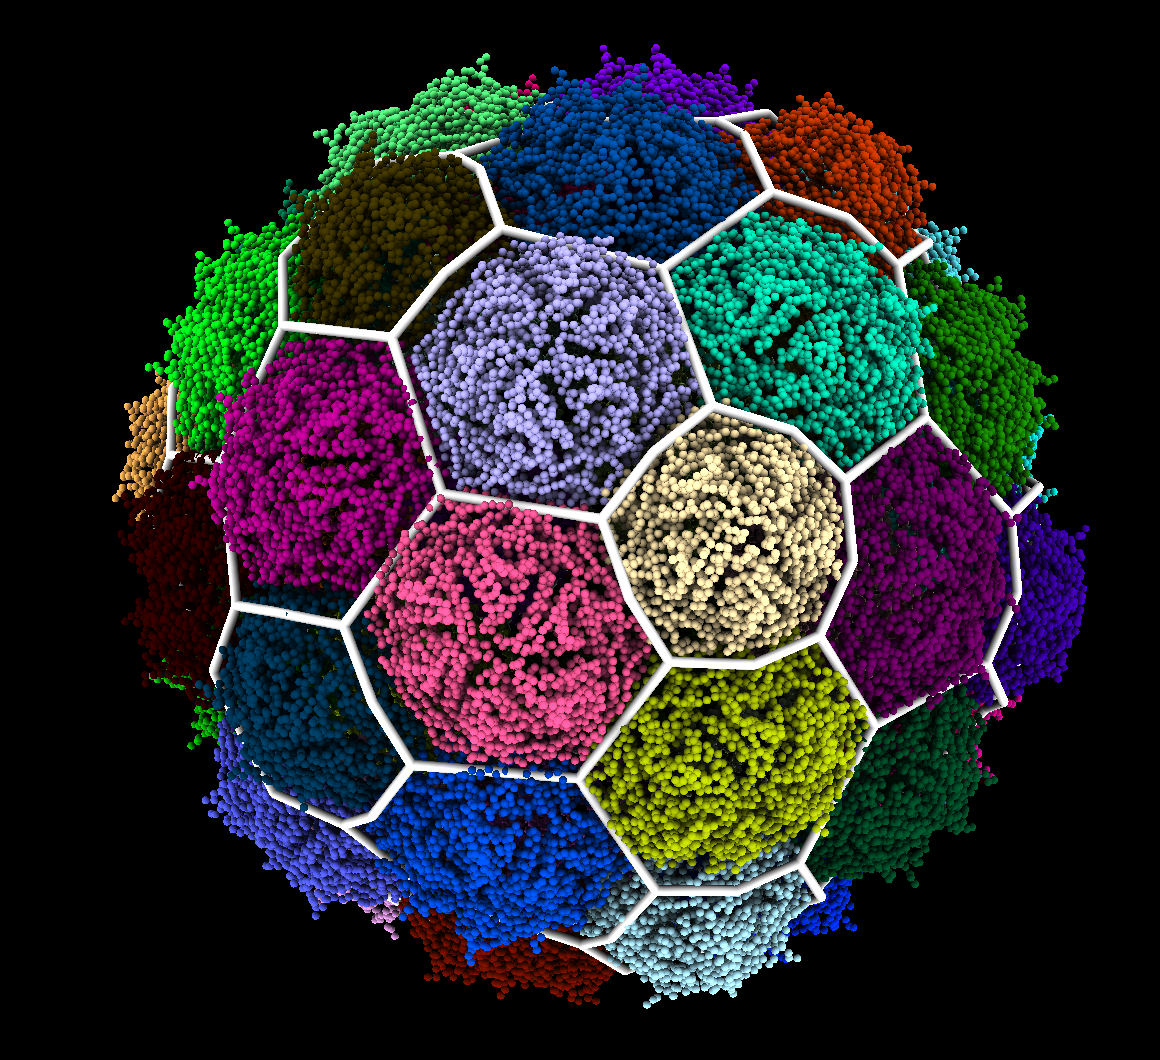
An Automated Method For Classifying Viral Capsid Geometry

Slide 2
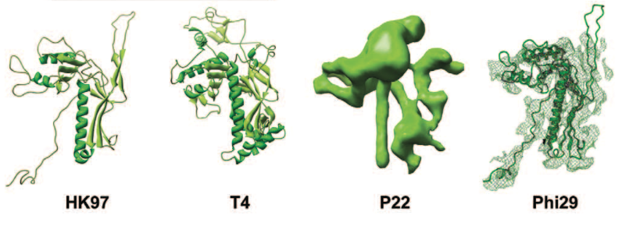
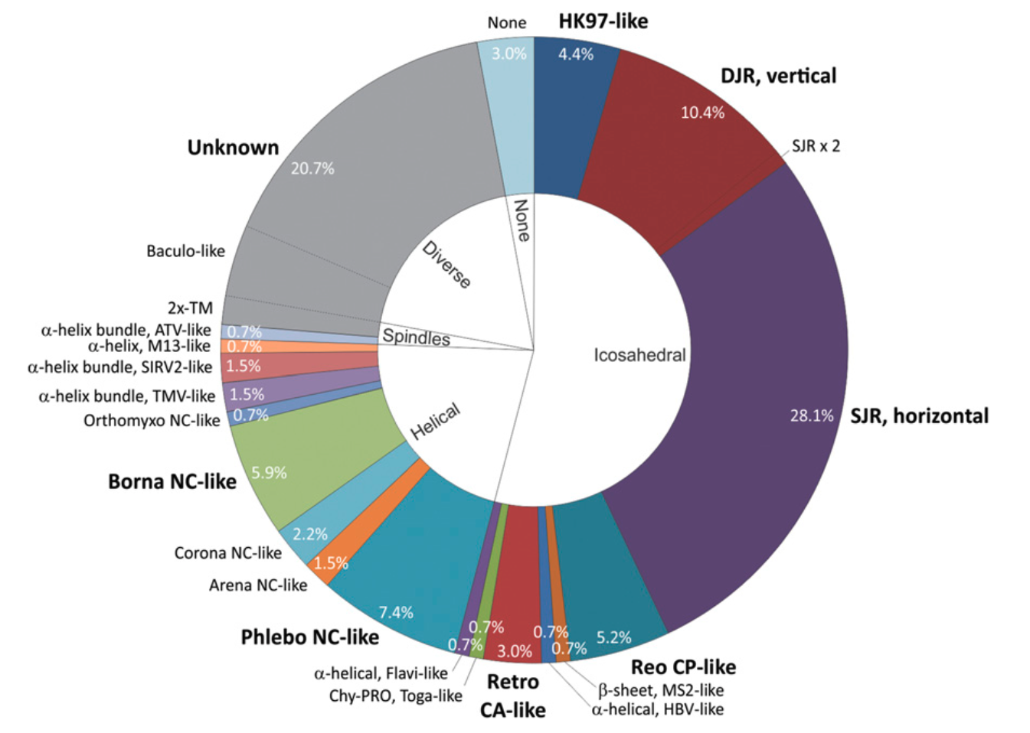
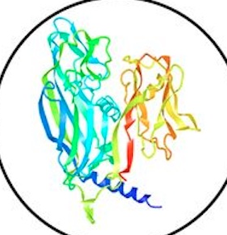
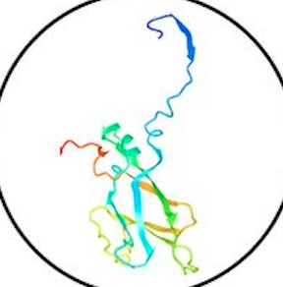
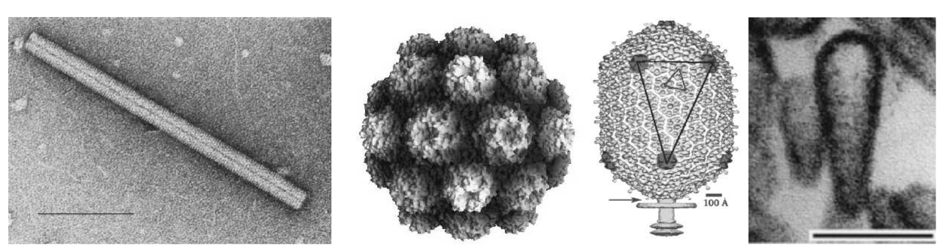
Icosahedral capsids dominate the virosphere
Viral Capsids
Contain the viral genome
Built from repeated units
Icosahedral Capsids
Highly symmetric
>90% of viruses
Krupovic and Koonin PNAS 2017
ICTVdB
Notes:
Short into to viruses (30 sec)
Viruses, in order to spread, need to be able to transport their genetic material. They achieve this by building protein shells called capsids. To save genome space used to encode proteins, they are built from many copies of a single Major Capsid Protein and adopt symmetrical structures. (Reference figure as the different type of capsid proteins)
1 min
Of the symmetries available to them Icosahedral symmetry is the most common and more than 90% of viruses on the planet adopt it. My research will focus on a particular variety of protein fold, that being the HK97 fold, which exclusively builds icosahedral capsids.

Slide 3
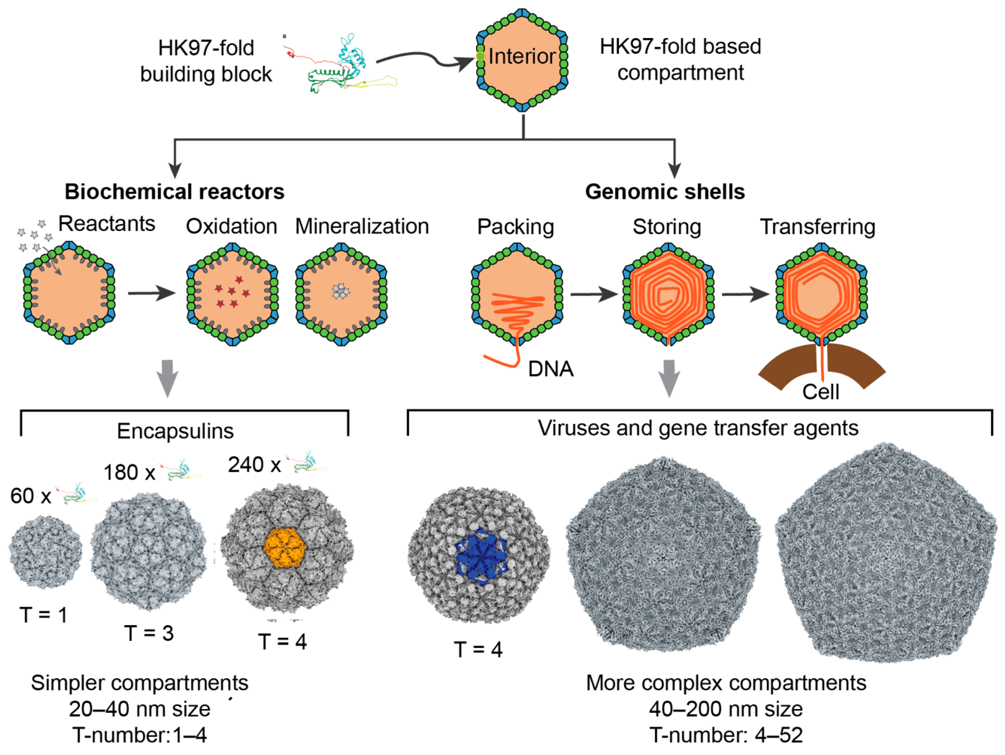
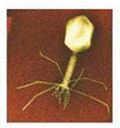
HK97-Like Folds
HK97-fold
Tailed bacteriophages
50%-90% of viral particles in the environment
Luque, Benler, Lee, Brown, White Microorganisms 2020
Notes:
1 min (Figure mentioning High variation in MCP sequence)
Variations on the hk97 fold fold are found in a variety of architectures in both Encapsulins, which serve as storage compartments and reactors (needs work), and viral capsids of tailed phages. The smallest encapsulin has a radius of 120 Angst and the largest capsid having a radius of ~800 Angst. Despite the variety in size and in the protein’s sequence, the hexagonal patterns on the surface are well conserved.

Slide 4
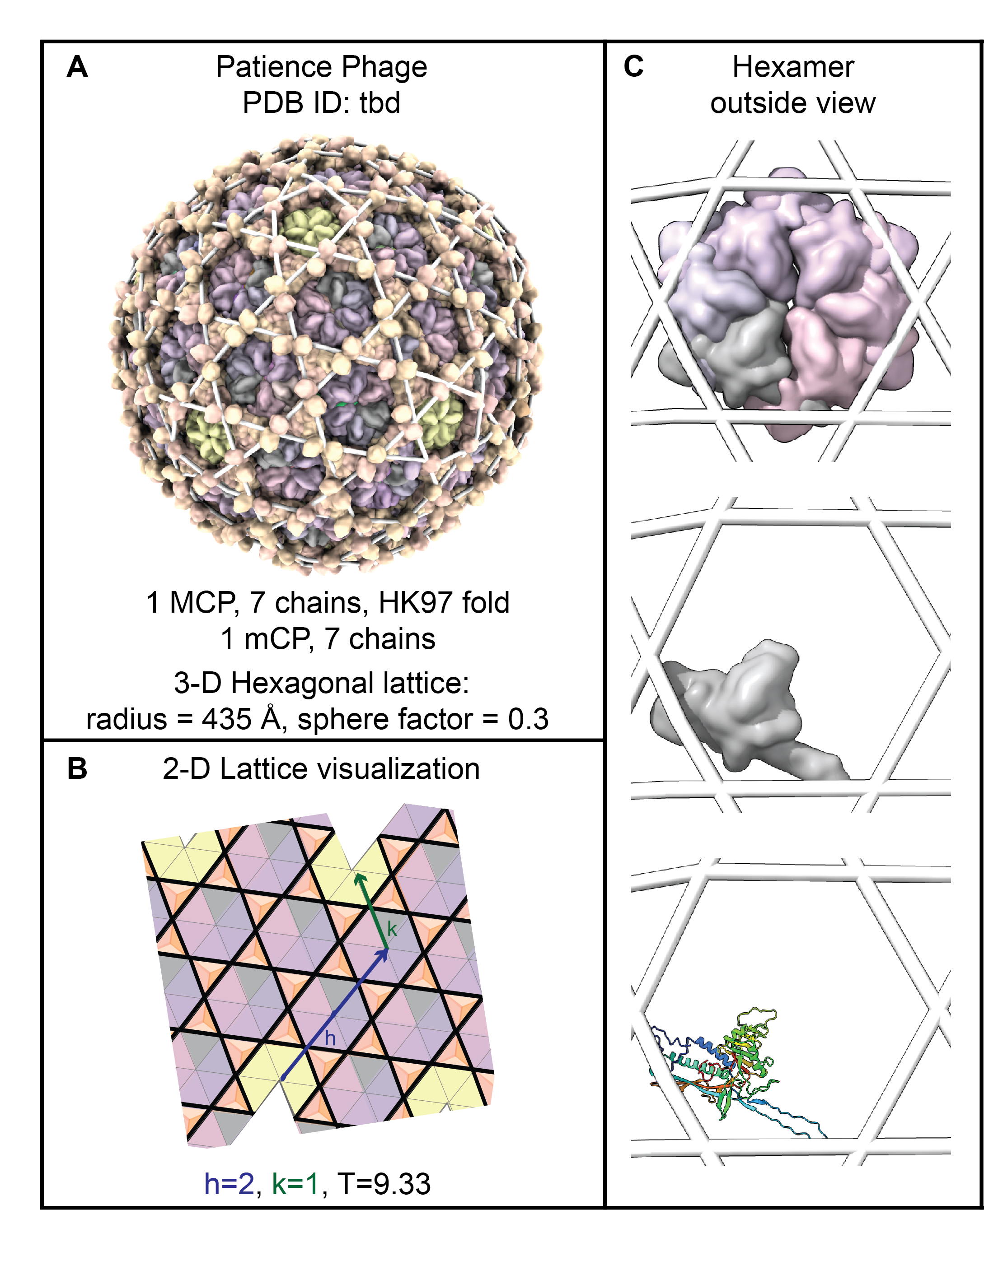
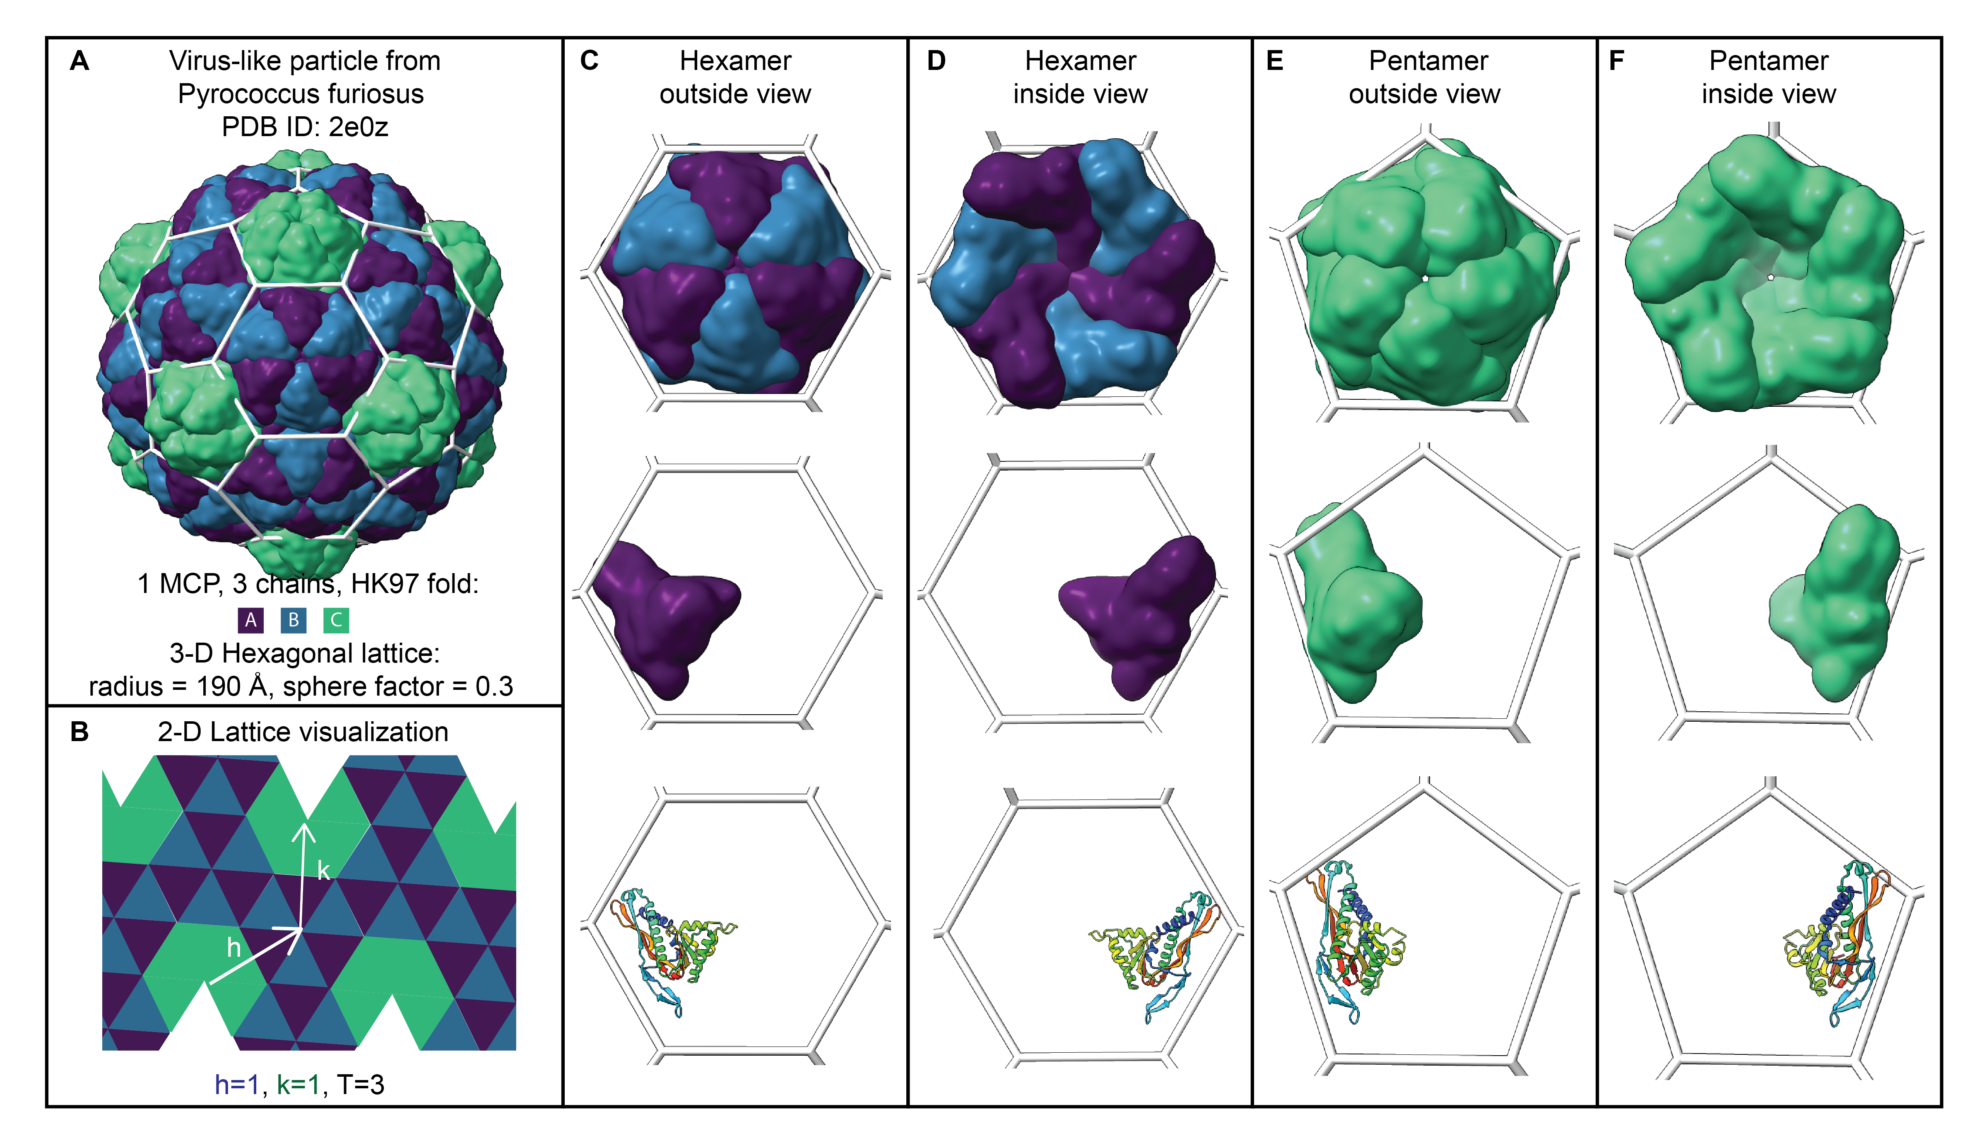
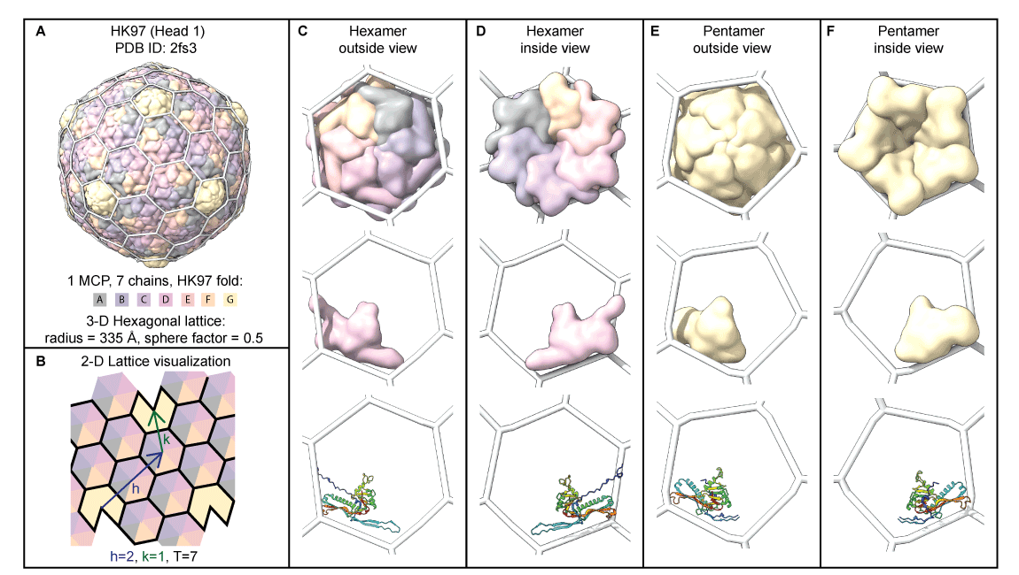
Classifying Icosahedral Capsid Geometry
Luque, Lee, Brown, Bartels, In Preparation
Notes:
1min 30sec
In the lab we’re currently using geometric methods of classifying capsid geometry. Core to our method is assuming that proteins group into capsomers that fit within these polygons. We align the capsid models with a geometric structure created using the hkcage tool in ChimeraX. The ability to create these 3d structures in the non-hexagonal case was developed by me in my previous work with the lab. This geometric method is done by hand, and sometimes it is not easy to select a specific classification. This prompted us to develop a method that is both automated and mechanical in nature.

Slide 5
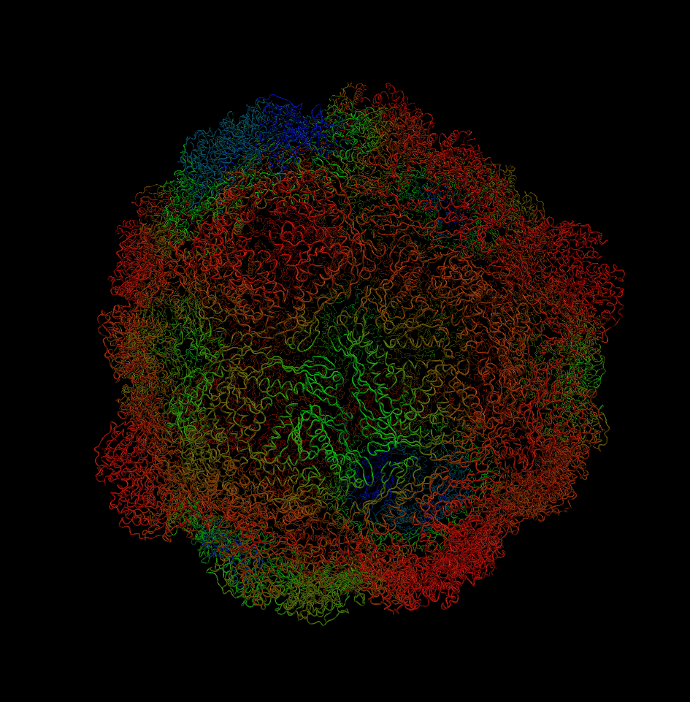
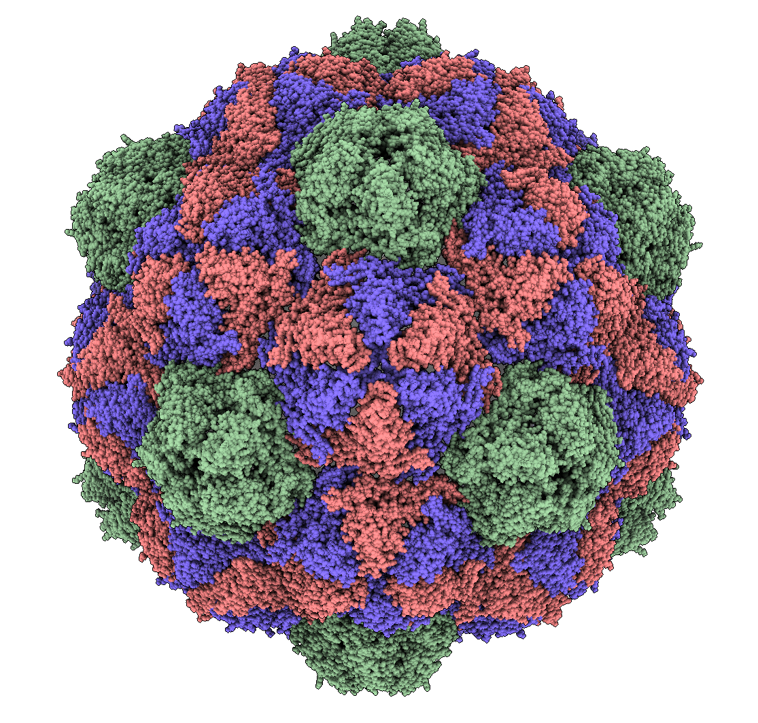
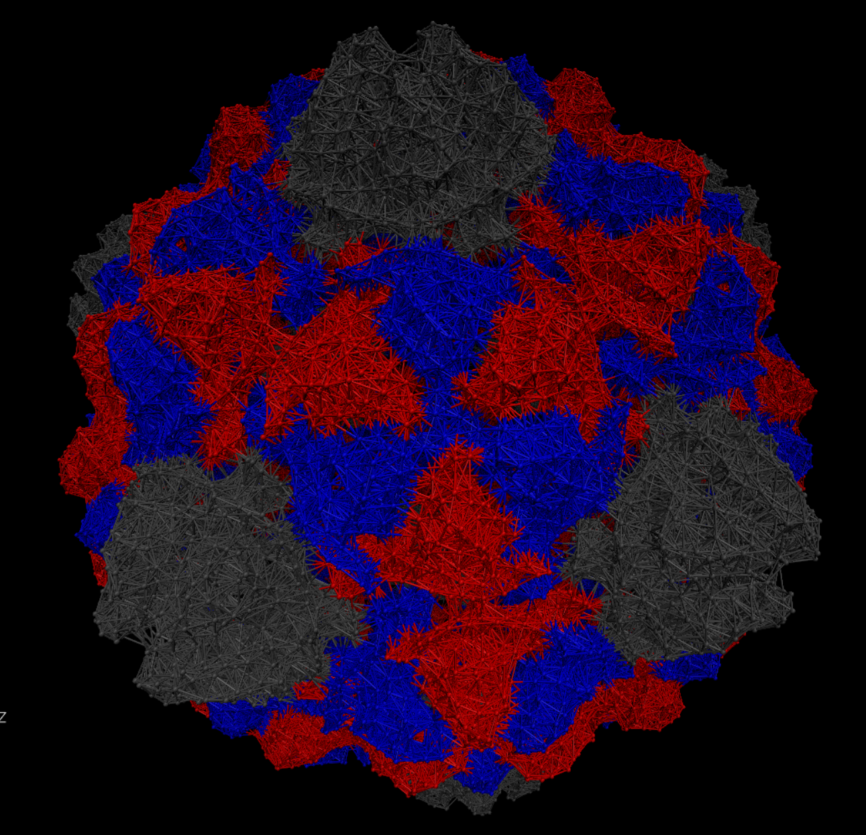
Step 1: Physical Model
Normal Mode Analysis
Atomic model
Elastic Network Model
Notes:
1min
We begin with the same atomic models we were using for our geometric classification, but simplify greatly by using only the Carbon-alpha atoms to build an elastic network model. Representing each of the carbon alpha atoms as a mass connected to nearby atoms by springs. We use a technique called normal mode analysis to determine the equilibrium dynamics of the capsid.

Slide 6
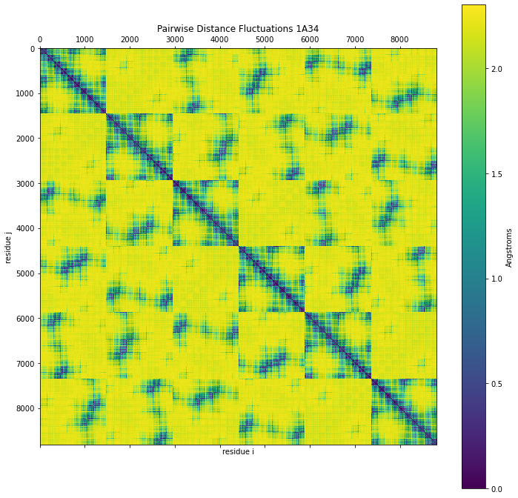
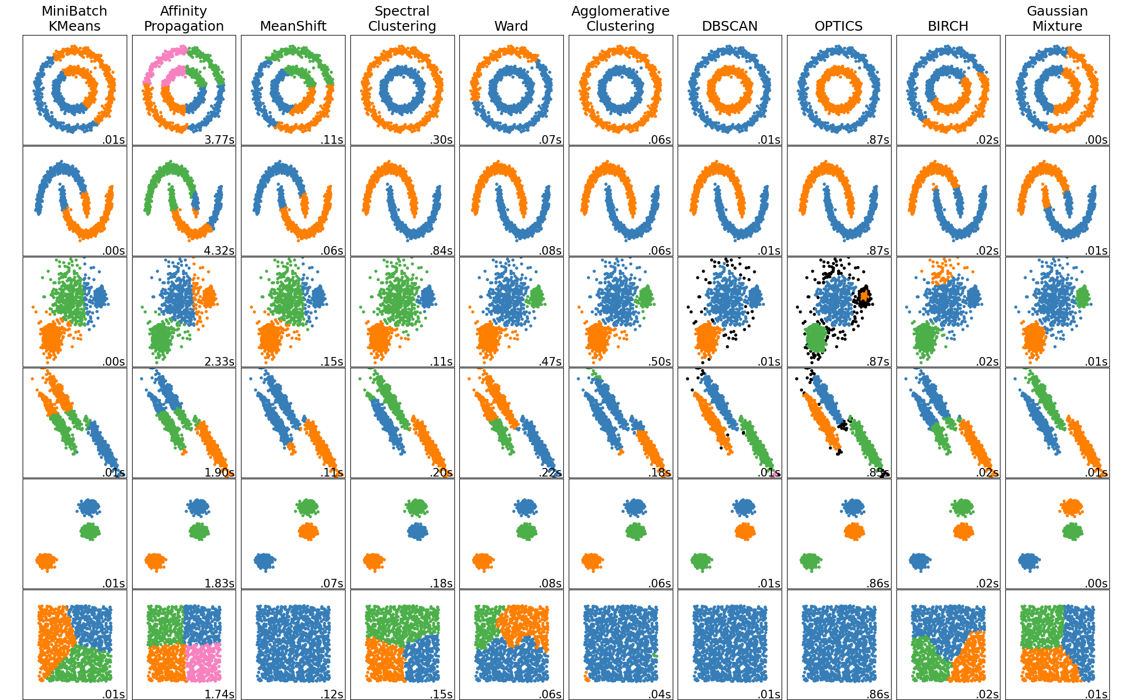
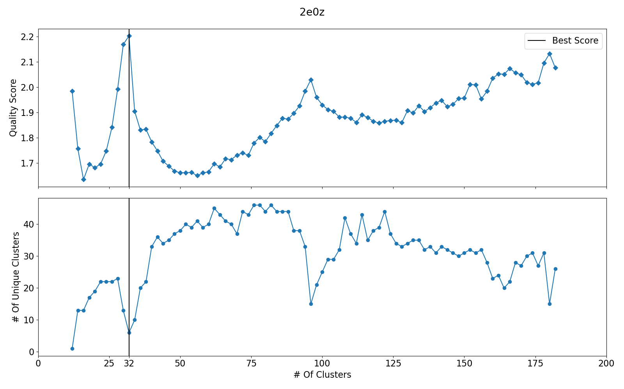
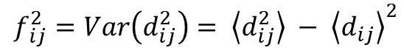
Step 2: Quasi-Rigid Subdivision
Spectral Clustering
Distance Fluctuations From NMA
Scoring & Selection
https://scikit-learn.org/stable/modules/clustering.html
$$f_{ ij}^{2}=Var\left(d_{ij}^{2}\right)= \left\langle d_{ij}^{2}\right\rangle − {\left\langle d_{ij}\right\rangle }^{2}$$
Ponzoni, Polles Structure 2015
Notes:
Now we want to use this model to identify our capsomers, a straightforward way to do so is finding an optimal subdivision of our network. We aim to minimize the distance fluctuations between elements within a capsomer, a metric called quasi-rigidity. An efficient method of doing this for large capsids is a technique called spectral clustering with roots in graph theory. We perform this subdivision for many possible numbers of clusters and select a scoring method to determine the optimal cluster.

Slide 7
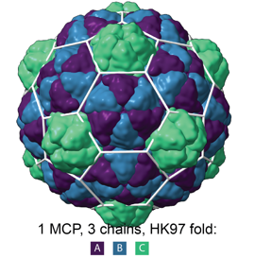
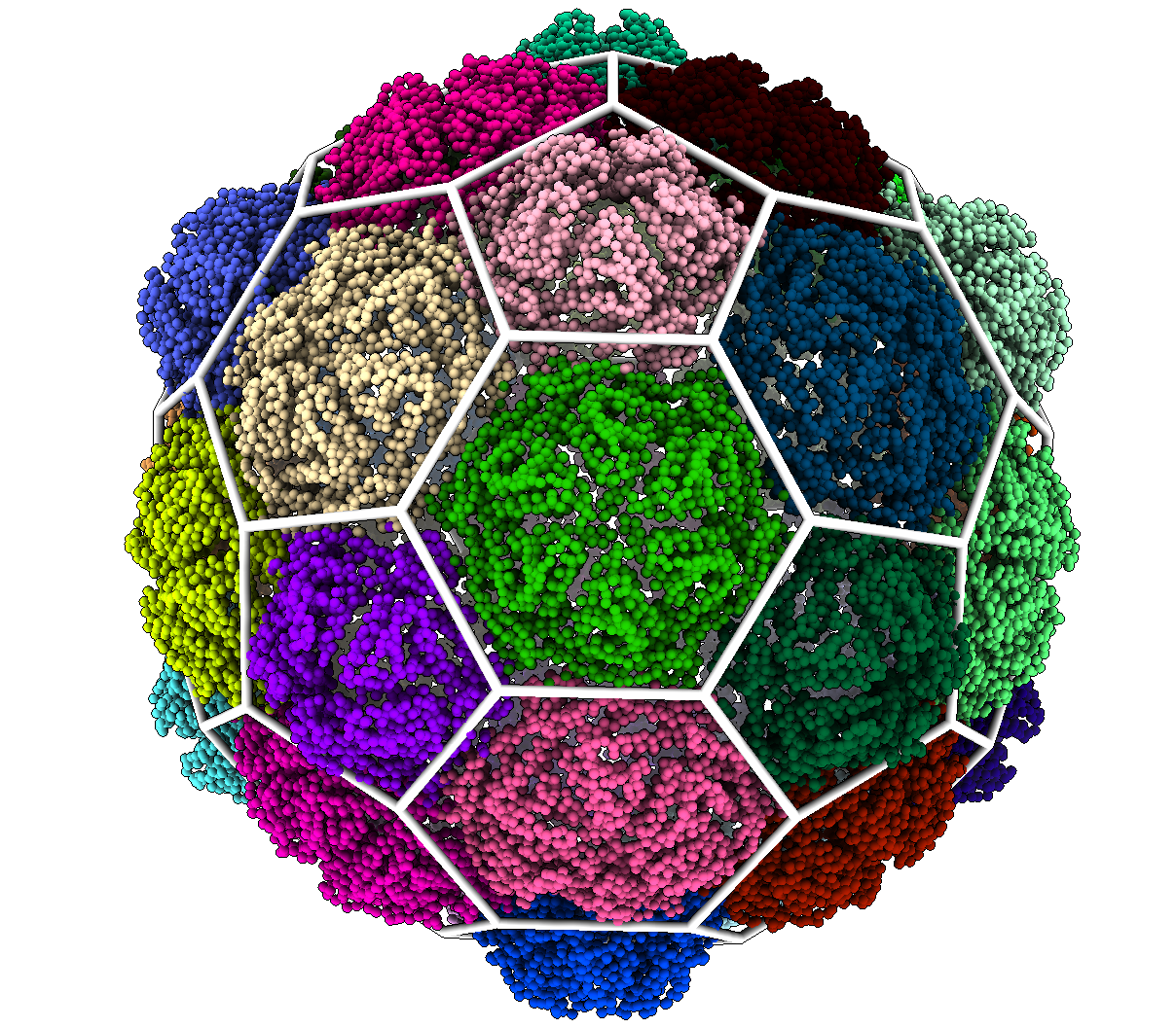
Step 3: Classification
Notes:
1min
Finally we connect our result back to our geometric classifications with the assumption that capsomers are quasi-rigid subunits. We overlay the 3d structures and select a classification based on the subdivision coloring.

Slide 8
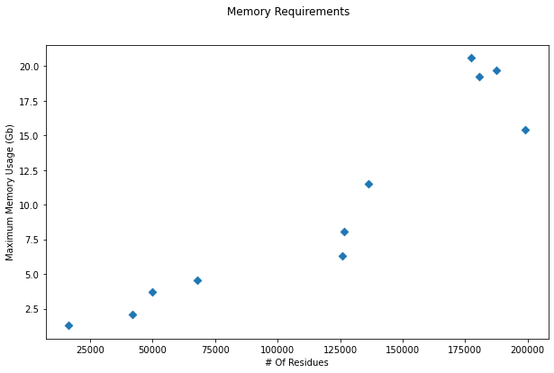
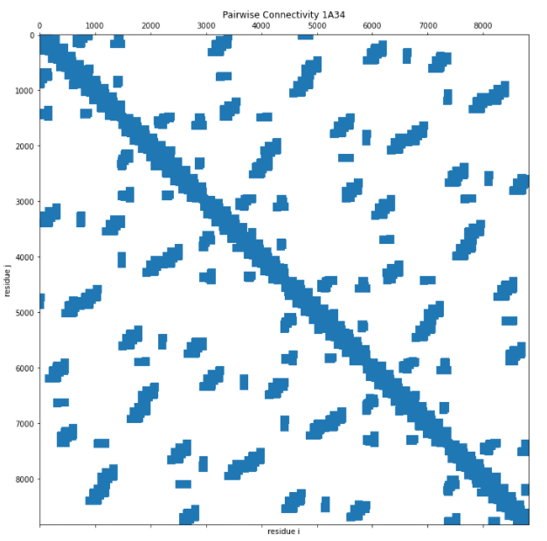
NMA Performance
Sparse Matrices
Size & Density
Notes:
The main computational bottleneck of our method is the memory required for the Normal Mode Analysis. We save memory by only including interactions between connected residues. This means the memory requirements are a function of both the number of alpha carbon atoms and their density.

Slide 9
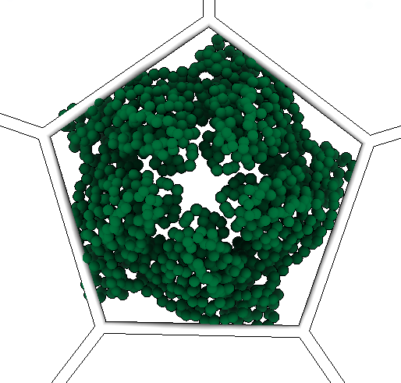
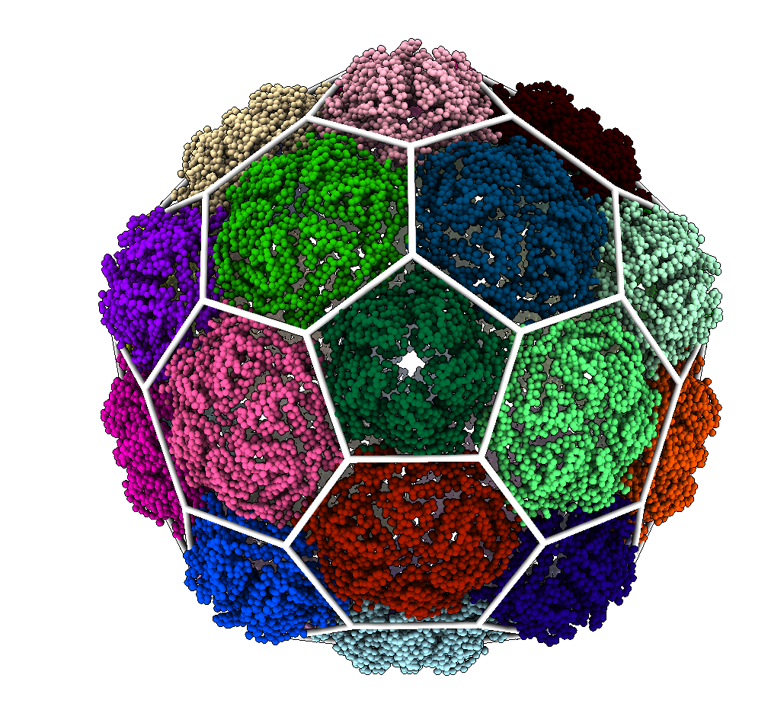
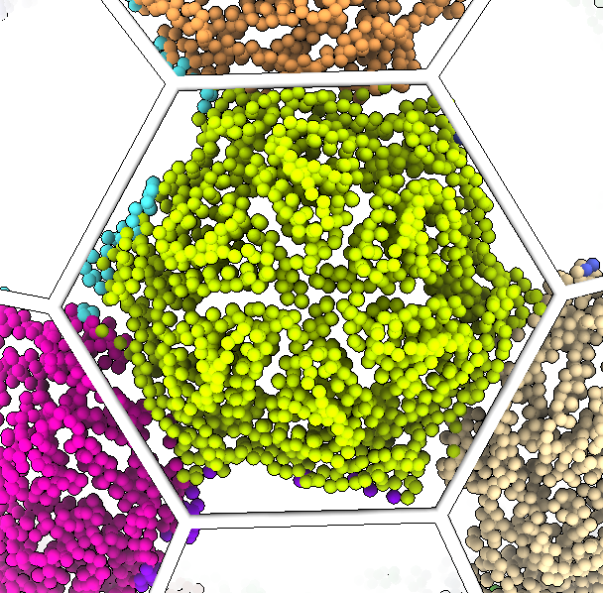
Results – Comparison With Geometric
Notes:
1min
When examining a simple hexagonal capsid we see that our method matches our geometric analysis well. However, some residues on the edge of proteins are assigned to adjacent clusters.

Slide 10
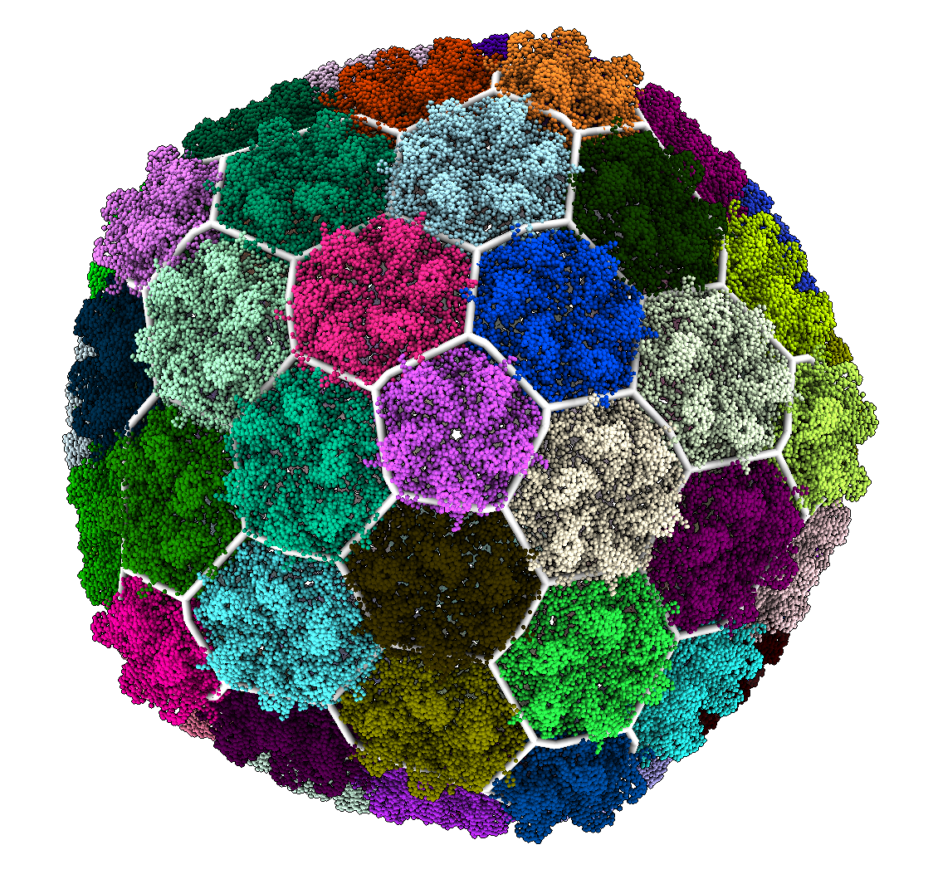
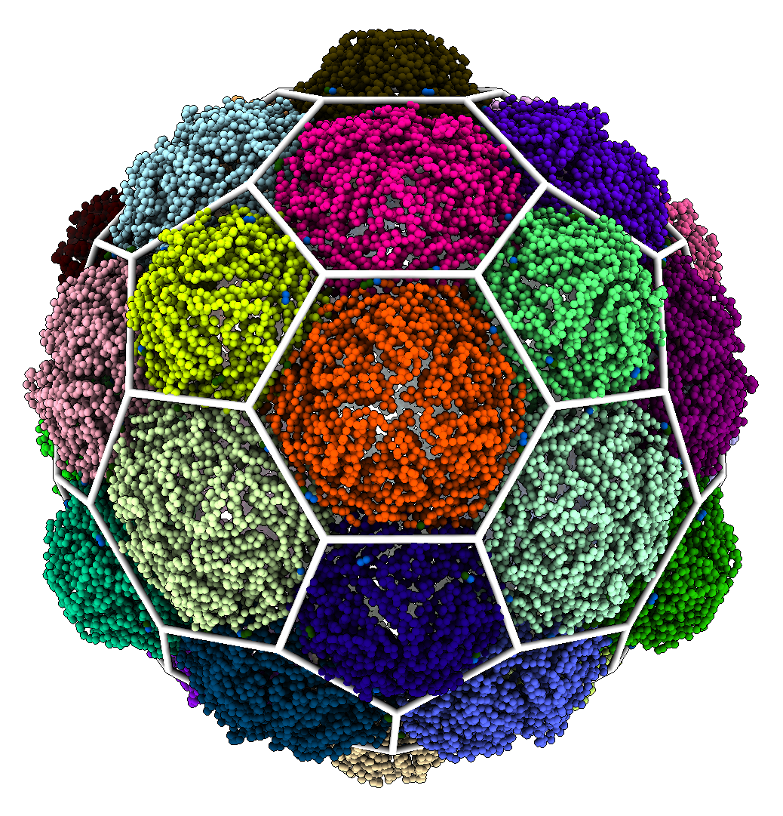
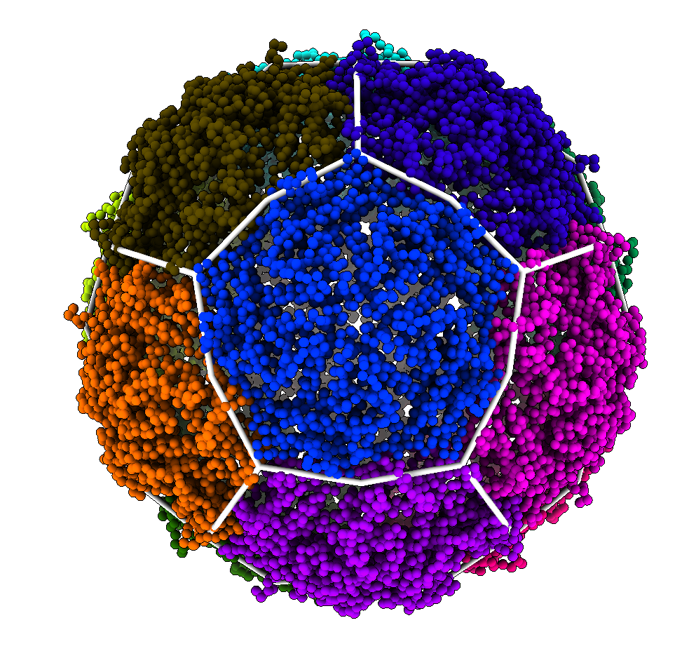
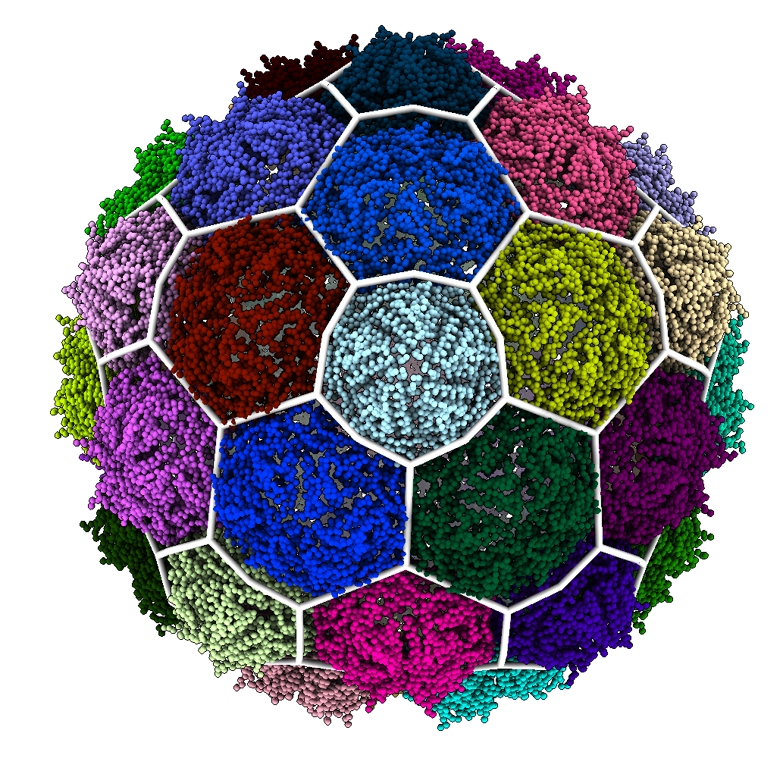
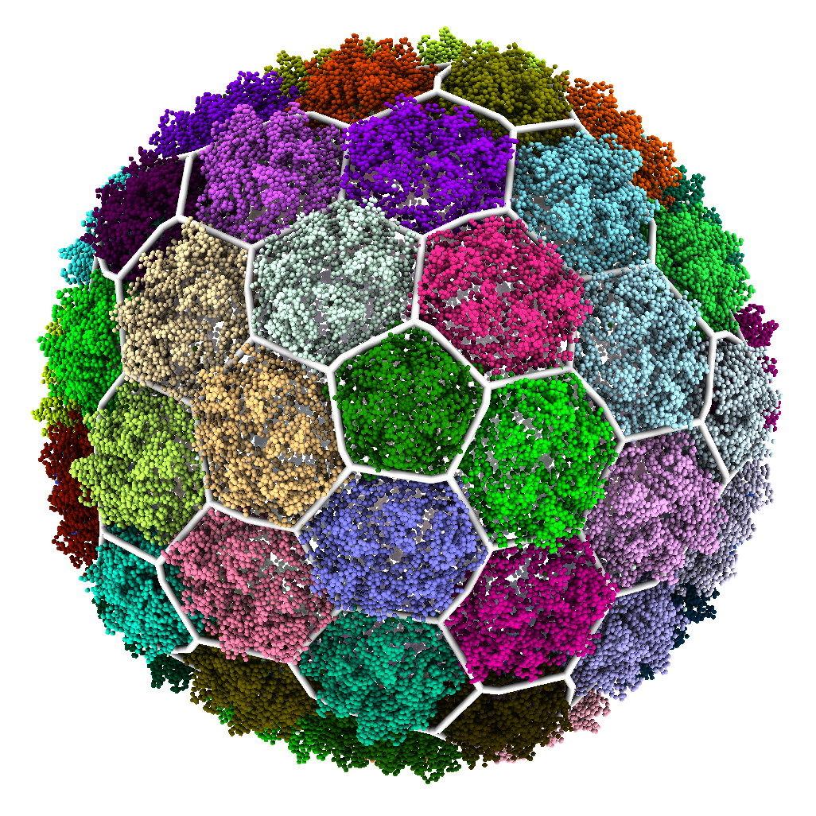
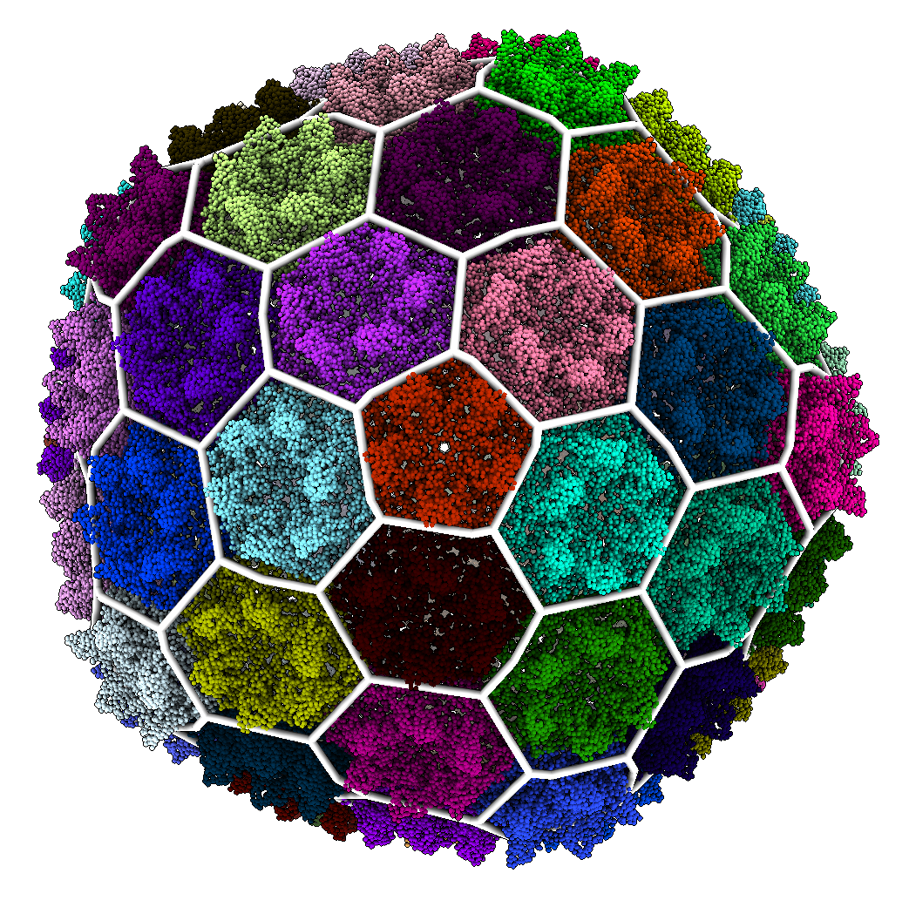
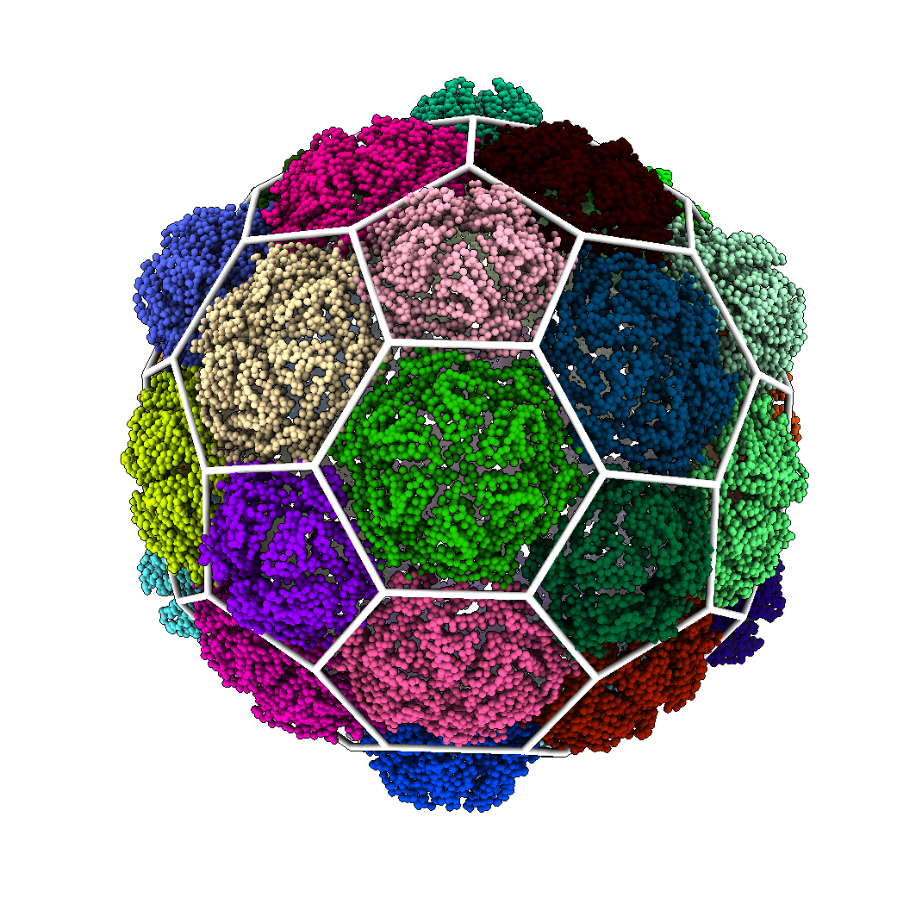
Results - Hexagonal
60 MCPs
180 MCPs
240 MCPs
420 MCPs

Slide 11
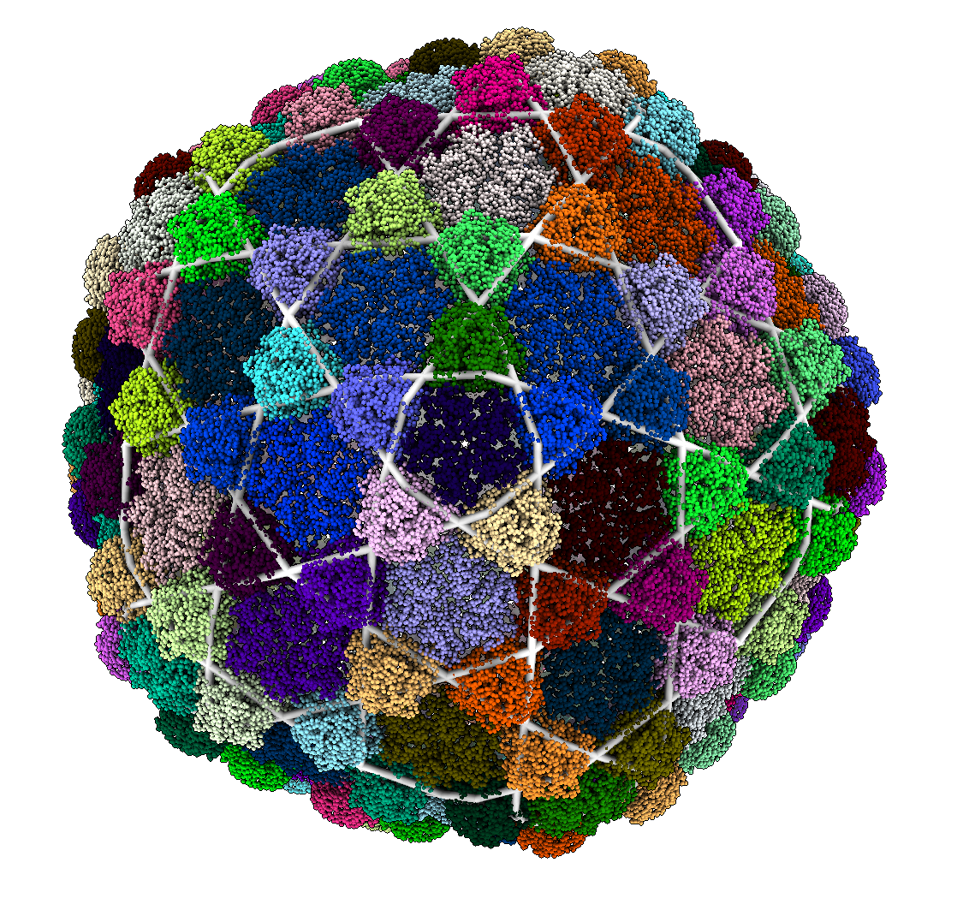
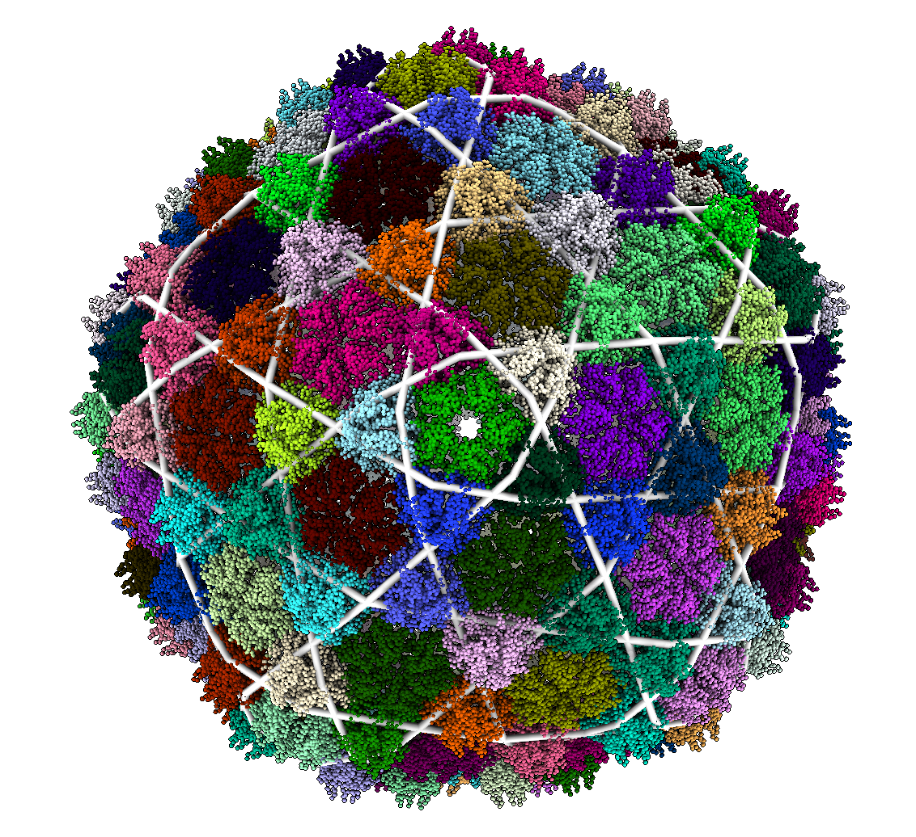
Results – Trihexagonal
420 MCPs & 140 Reinforcement Proteins

Slide 12
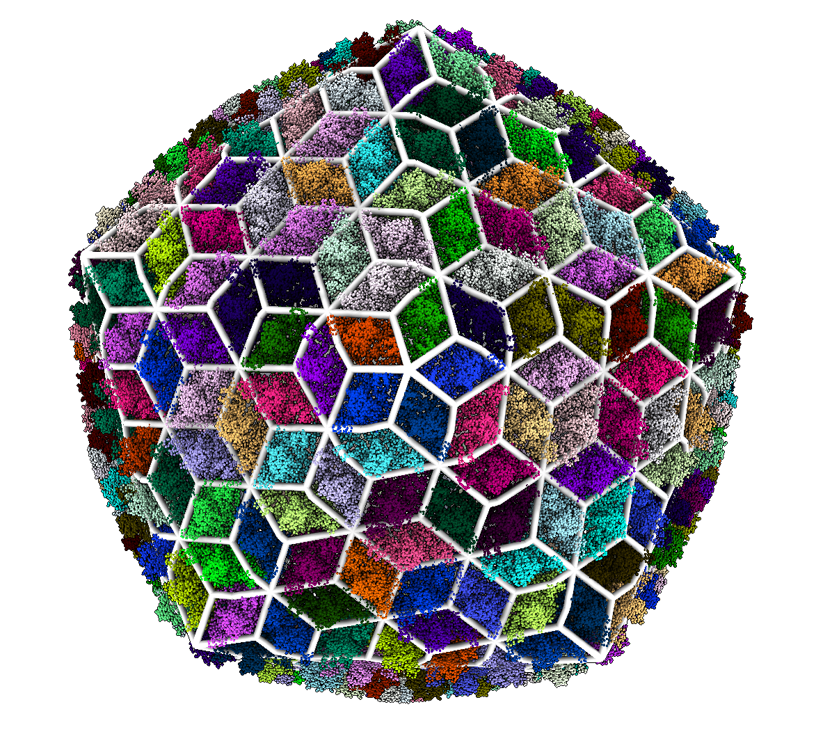
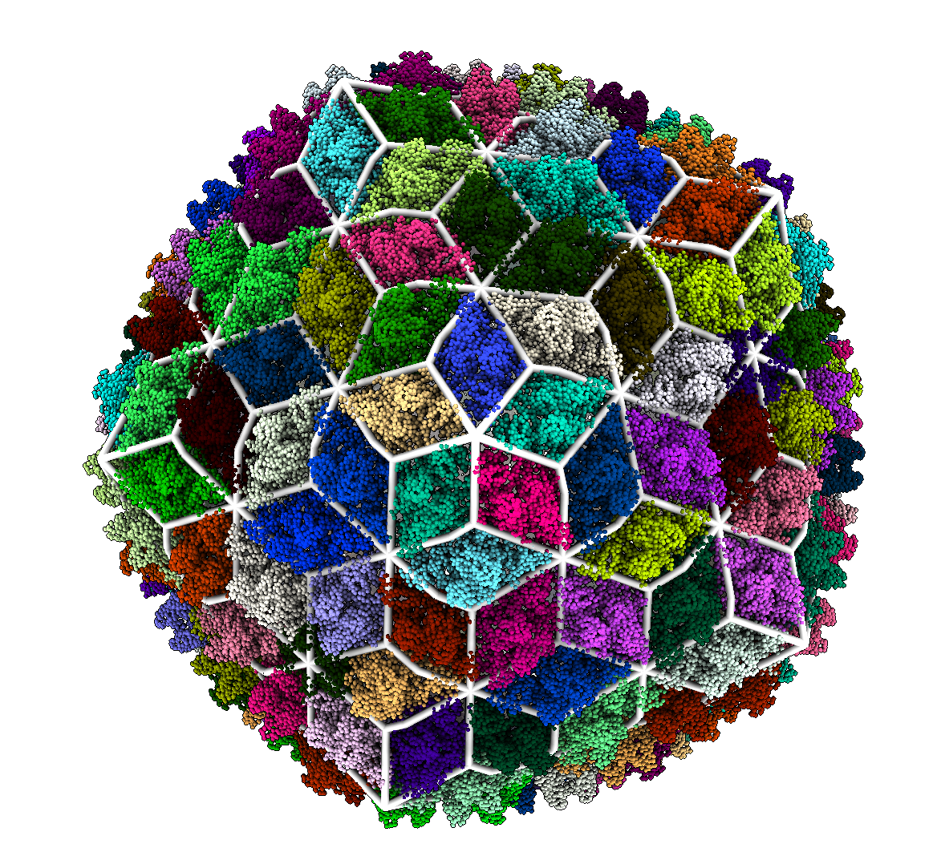
Results – Trihexagonal-Dual
780 MCPs & 260 Reinforcement Proteins
420 MCPs & 140 Reinforcement Proteins

Slide 13
Conclusion
HK97-Fold
Hexagonal Structure is well conserved
Only changes in the presence of additional proteins
Some domains cross into other subunits
Automated Classification
The tool may be improved with symmetry
The methods used may be adjusted in a modular way
Notes:
1 min
Hexagonal structure is always present. The tool lent significant weight to the presence of reinforcement proteins. Some protein domains were instead assigned to other subunits.
The

Slide 14
Questions
Notes:
Ask if I should put contact info

Slide 15
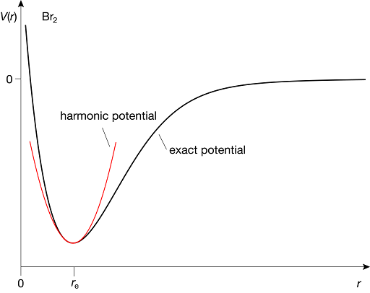
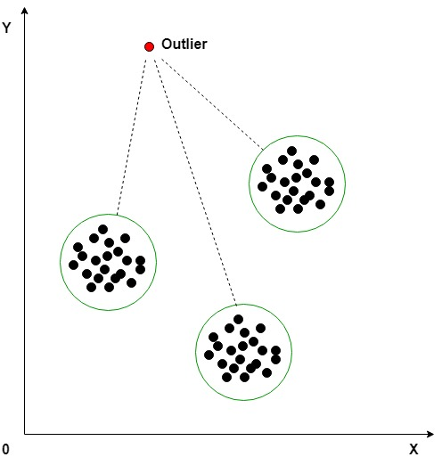
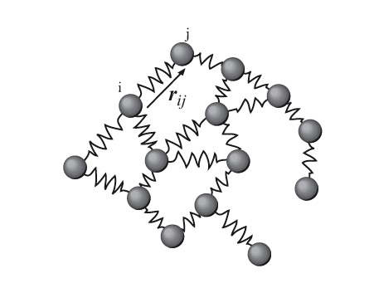
Model Assumptions & Limitations
Harmonic
Potentials
No Outlier Removal
ENM Coarse Graining
Subdivision Selection
Notes:
1min
We assume all potentials are harmonic and lose information on specific chemical bonds. We coarse grain the system to the level of individual residues missing detailed subunit interaction. We do not remove outliers and thus may include domains that are in no way rigid. Selecting the optimal subdivision requires a scoring metric and is a complex problem.
Talk to Diana a little, source the images.

Slide 16
Atomic model
Elastic Network Model
Normal modes analysis
Icosahedral lattice assignment
Scoring Subdivision
Eyal et al Bionformatics 2006
Bahar et al Chem Rev 2010
Polles et al. PLoS Comp Bio 2013
Ponzoni et al Structure 2015
Brown^{M} and Luque, In Preparation
Notes:
2min

Slide 17
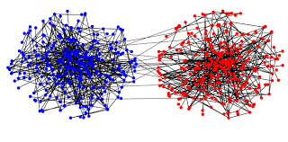
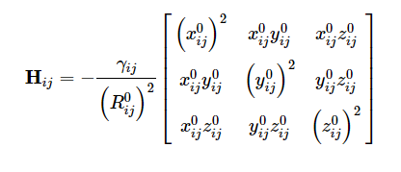
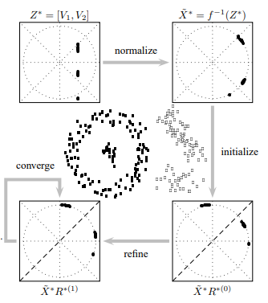
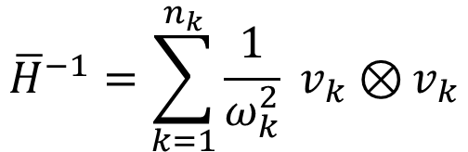
Performance
Constructing
Hessian
# Of Modes
Calculate Normal
Modes
$${\overline{H}}^{−1}=\sum_{k=1}^{n_{k}}{\frac{1}{ω_{k}^{2}} v_{k}⊗}v_{k}$$
Eigenvectors/Normal Modes
Lowest Frequencies
Yu, Shi, IEEE 2003
Notes:
1 min
4 main steps
Construct the hessian
Calculate Modes
Spectral Embedding
Clustering via Discretize

Slide 18
Capsid | T # | Additional Proteins | Result
Th. Maritima | 1 | None | Hexagonal
Pyr. Furiosus | 3 | None | Hexagonal
Myx. Xanthus | 3 | None | Hexagonal
Quasi. Thermo. | 4 | None | Hexagonal
P22 Mature | 7 | None | Hexagonal
Phage Sf6 | 7 | None | Hexagonal
Phage T7 | 7 | None | Hexagonal
Bordetella | 7 | 2-Fold Axis | Trihex-dual
Siphov. Mic1 | 7 | 2-Fold Axis | Trihex-dual
Sipho. TW1 | 7 | 3-Fold Axis | Trihexagonal
YSD1 Phage | 7 | 3-Fold Axis | Trihexagonal
Sipho TW1 | 13 | 2-Fold Axis | Trihex-dual

Slide 19
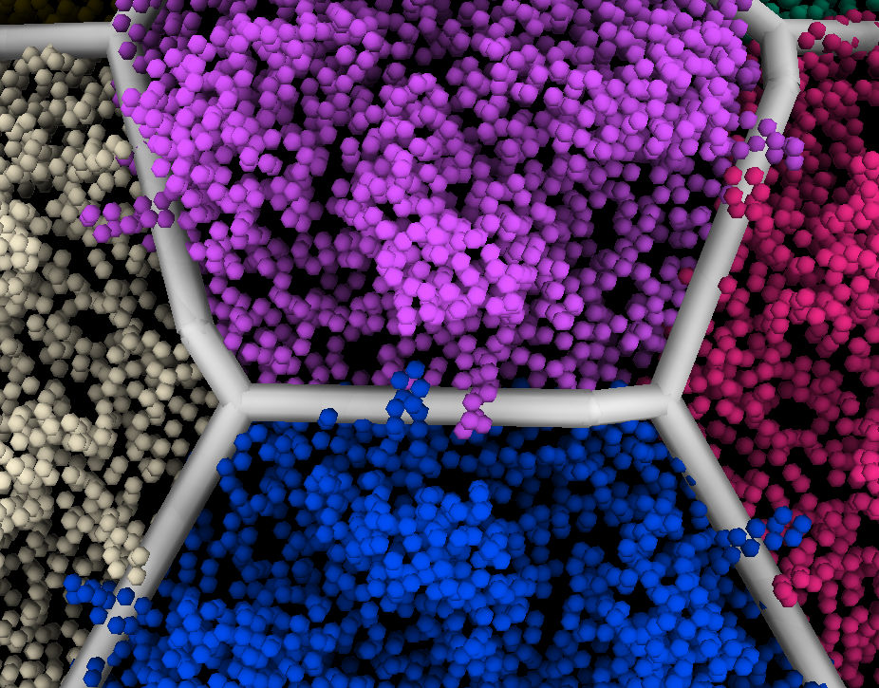
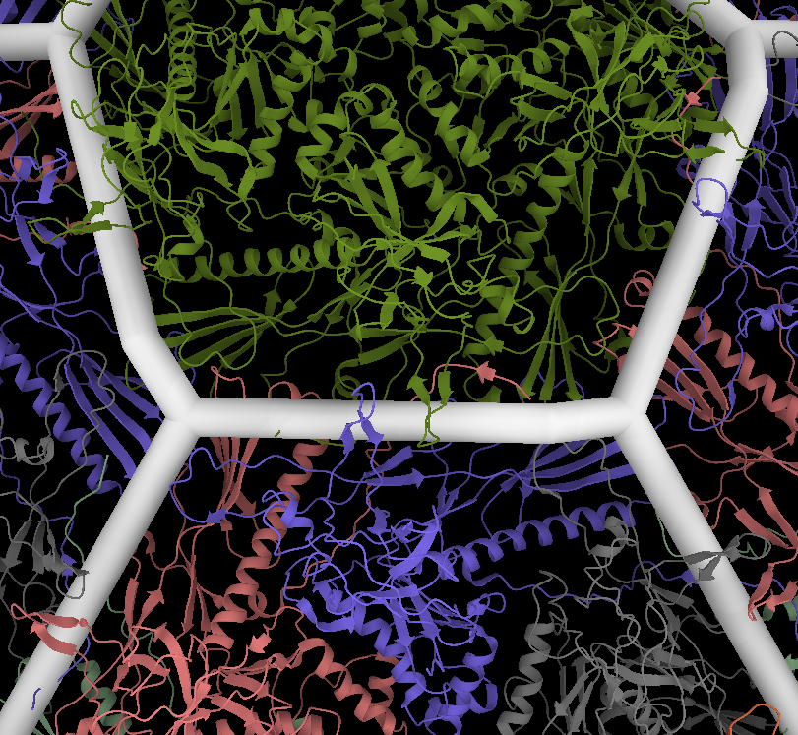
What domains extend beyond clusters
Zoomed In Comparison of domains. N-domain, what capsid?
Notes:
Need to improve this comparison significantly. Ask for Diana’s help

Slide 20
Quasi-Rigid Domain Decomposition
We implement the method described in (Ponzoni & Polles 2015) to identify quasi-rigid domains
Represent the capsid using an Elastic Network Model (ENM)
Apply Normal Mode Analysis to approximate the pairwise distance fluctuations between residues
Use Spectral Clustering techniques to optimally divide the capsid into quasi-rigid domains
Visualize the result and assign a geometric classification based on the clusters

